Slide 1

Big Data Infrastructure
Session 6: MapReduce – Data Mining
Jimmy Lin
University of Maryland
Monday, March 9, 2015
This work is licensed under a Creative Commons Attribution-Noncommercial-Share Alike 3.0 United States See http://creativecommons.org/licenses/by-nc-sa/3.0/us/ for details

Slide 2
Today’s Agenda
Clustering
Classification

Slide 3
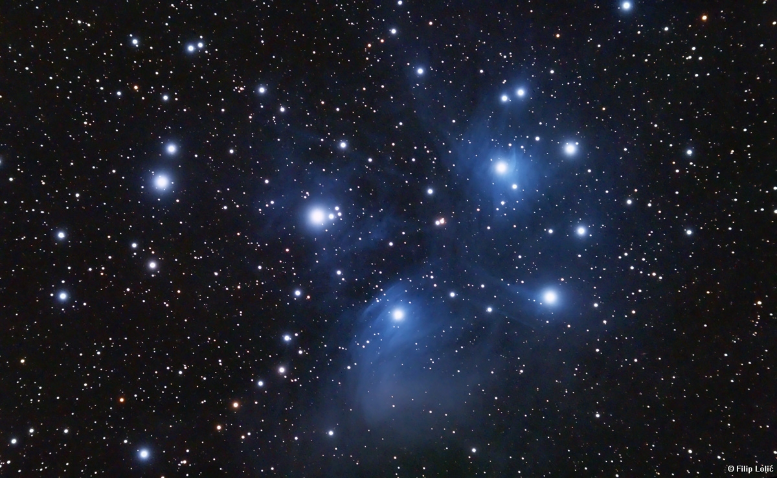
Clustering
Source: Wikipedia (Star cluster)

Slide 4
Problem Setup
Arrange items into clusters
High similarity (low distance) between objects in the same cluster
Low similarity (high distance) between objects in different clusters
Cluster labeling is a separate problem

Slide 5
Applications
Exploratory analysis of large collections of objects
Collection pre-processing for web search
Image segmentation
Recommender systems
Cluster hypothesis in information retrieval
Computational biology and bioinformatics
Many more!

Slide 6
Distance Metrics
Non-negativity:
Identity:
Symmetry:
Triangle Inequality

Slide 7
Distance: Jaccard
Given two sets A, B
Jaccard similarity:

Slide 8
Distance: Norms
Given:
Euclidean distance (L₂-norm)
Manhattan distance (L₁-norm)
L_{r}-norm

Slide 9
Distance: Cosine
Given:
Idea: measure distance between the vectors
Thus:

Slide 10
Distance: Hamming
Given two bit vectors
Hamming distance: number of elements which differ

Slide 11
Representations: Text
Unigrams (i.e., words)
Shingles = n-grams
At the word level
At the character level
Feature weights
boolean
tf.idf
BM25
…

Slide 12
Representations: Beyond Text
For recommender systems:
Items as features for users
Users as features for items
For graphs:
Adjacency lists as features for vertices
With log data:
Behaviors (clicks) as features

Slide 13

Minhash
Source: www.flickr.com/photos/rheinitz/6158837748/

Slide 14
Near-Duplicate Detection of Webpages
What’s the source of the problem?
Mirror pages (legit)
Spam farms (non-legit)
Additional complications (e.g., nav bars)
Naïve algorithm:
Compute cryptographic hash for webpage (e.g., MD5)
Insert hash values into a big hash table
Compute hash for new webpage: collision implies duplicate
What’s the issue?
Intuition:
Hash function needs to be tolerant of minor differences
High similarity implies higher probability of hash collision

Slide 15
Minhash
Seminal algorithm for near-duplicate detection of webpages
Used by AltaVista
For details see Broder et al. (1997)
Setup:
Documents (HTML pages) represented by shingles (n-grams)
Jaccard similarity: dups are pairs with high similarity

Slide 16
Preliminaries: Representation
Sets:
A = {e₁, e₃, e₇}
B = {e₃, e₅, e₇}
Can be equivalently expressed as matrices:
Element | A | B
e₁ | 1 | 0
e₂ | 0 | 0
e₃ | 1 | 1
e₄ | 0 | 0
e₅ | 0 | 1
e₆ | 0 | 0
e₇ | 1 | 1

Slide 17
Preliminaries: Jaccard
Element | A | B
e₁ | 1 | 0
e₂ | 0 | 0
e₃ | 1 | 1
e₄ | 0 | 0
e₅ | 0 | 1
e₆ | 0 | 0
e₇ | 1 | 1
Let:
M₀₀ = # rows where both elements are 0
M₁₁ = # rows where both elements are 1
M₀₁ = # rows where A=0, B=1
M₁₀ = # rows where A=1, B=0

Slide 18
Minhash
Computing minhash
Start with the matrix representation of the set
Randomly permute the rows of the matrix
minhash is the first row with a “one”
Example:
h(A) = e₃
h(B) = e₅
Element | A | B
e₁ | 1 | 0
e₂ | 0 | 0
e₃ | 1 | 1
e₄ | 0 | 0
e₅ | 0 | 1
e₆ | 0 | 0
e₇ | 1 | 1
Element | A | B
e₆ | 0 | 0
e₂ | 0 | 0
e₅ | 0 | 1
e₃ | 1 | 1
e₇ | 1 | 1
e₄ | 0 | 0
e₁ | 1 | 0

Slide 19
Minhash and Jaccard
Element | A | B
e₆ | 0 | 0
e₂ | 0 | 0
e₅ | 0 | 1
e₃ | 1 | 1
e₇ | 1 | 1
e₄ | 0 | 0
e₁ | 1 | 0
M₀₀
M₀₀
M₀₁
M₁₁
M₁₁
M₀₀
M₁₀

Slide 20
To Permute or Not to Permute?
Permutations are expensive
Interpret the hash value as the permutation
Only need to keep track of the minimum hash value
Can keep track of multiple minhash values at once

Slide 21
Extracting Similar Pairs (LSH)
We know:
Task: discover all pairs with similarity greater than s
Algorithm:
For each object, compute its minhash value
Group objects by their hash values
Output all pairs within each group
Analysis:
Probability we will discovered all pairs is s
Probability that any pair is invalid is (1 – s)
What’s the fundamental issue?

Slide 22
Two Minhash Signatures
Task: discover all pairs with similarity greater than s
Algorithm:
For each object, compute two minhash values and concatenate together into a signature
Group objects by their signatures
Output all pairs within each group
Analysis:
Probability we will discovered all pairs is s²
Probability that any pair is invalid is (1 – s)²

Slide 23
k Minhash Signatures
Task: discover all pairs with similarity greater than s
Algorithm:
For each object, compute k minhash values and concatenate together into a signature
Group objects by their signatures
Output all pairs within each group
Analysis:
Probability we will discovered all pairs is s^{k}
Probability that any pair is invalid is (1 – s)^{k}
What’s the issue now?

Slide 24
n different k Minhash Signatures
Task: discover all pairs with similarity greater than s
Algorithm:
For each object, compute n sets k minhash values
For each set, concatenate k minhash values together
Within each set:
Group objects by their signatures
Output all pairs within each group
De-dup pairs
Analysis:
Probability we will miss a pair is (1 – s^{k} )^{n}
Probability that any pair is invalid is n(1 – s)^{k}

Slide 25
Practical Notes
In some cases, checking all candidate pairs may be possible
Time cost is small relative to everything else
Easy method to discard false positives
Most common practical implementation:
Generate M minhash values, randomly select k of them n times
Reduces amount of hash computations needed
Determining “authoritative” version is non-trivial

Slide 26
MapReduce Implementation
Map over objects:
Generate M minhash values, randomly select k of them n times
Each draw yields a signature: emit as intermediate key, value is object id
Shuffle/sort:
Reduce:
Receive all object ids with same signature, emit clusters
Second pass to de-dup and group clusters

Slide 27
General Clustering Approaches
Hierarchical
K-Means
Gaussian Mixture Models

Slide 28
Hierarchical Agglomerative Clustering
Start with each document in its own cluster
Until there is only one cluster:
Find the two clusters c_{i} and c_{j}, that are most similar
Replace c_{i} and c_{j} with a single cluster c_{i} ∪ c_{j}
The history of merges forms the hierarchy

Slide 29
HAC in Action
A B C D E F G H

Slide 30
Cluster Merging
Which two clusters do we merge?
What’s the similarity between two clusters?
Single Link: similarity of two most similar members
Complete Link: similarity of two least similar members
Group Average: average similarity between members

Slide 31
Link Functions
Single link:
Uses maximum similarity of pairs:
Can result in “straggly” (long and thin) clusters due to chaining effect
Complete link:
Use minimum similarity of pairs:
Makes more “tight” spherical clusters

Slide 32
MapReduce Implementation
What’s the inherent challenge?

Slide 33
K-Means Algorithm
Let d be the distance between documents
Define the centroid of a cluster to be:
Select k random instances {s₁, s₂,… s_{k}} as seeds.
Until clusters converge:
Assign each instance x_{i} to the cluster c_{j} such that d(x_{i}, s_{j}) is minimal
Update the seeds to the centroid of each cluster
For each cluster c_{j}, s_{j} = μ(c_{j})

Slide 34
K-Means Clustering Example
Pick seeds
Reassign clusters
Compute centroids
Reassign clusters
◉
◉
Compute centroids
◉
◉
Reassign clusters
Converged!

Slide 35
Basic MapReduce Implementation
(Just a clever way to keep track of denominator)

Slide 36
MapReduce Implementation w/ IMC

Slide 37
Implementation Notes
Standard setup of iterative MapReduce algorithms
Driver program sets up MapReduce job
Waits for completion
Checks for convergence
Repeats if necessary
Must be able keep cluster centroids in memory
With large k, large feature spaces, potentially an issue
Memory requirements of centroids grow over time!
Variant: k-medoids

Slide 38
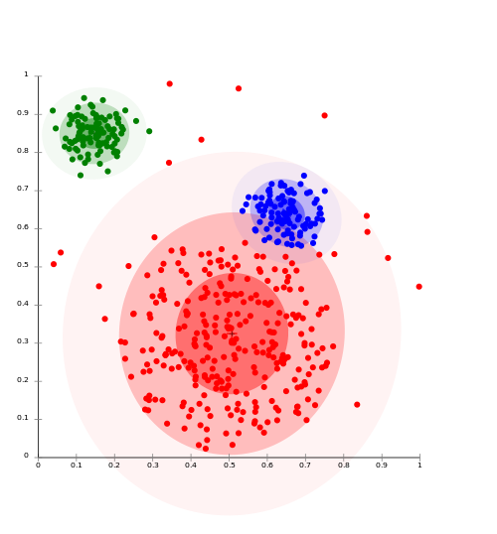
Clustering w/ Gaussian Mixture Models
Model data as a mixture of Gaussians
Given data, recover model parameters
Source: Wikipedia (Cluster analysis)

Slide 39
Gaussian Distributions
Univariate Gaussian (i.e., Normal):
A random variable with such a distribution we write as:
Multivariate Gaussian:
A vector-value random variable with such a distribution we write as:

Slide 40
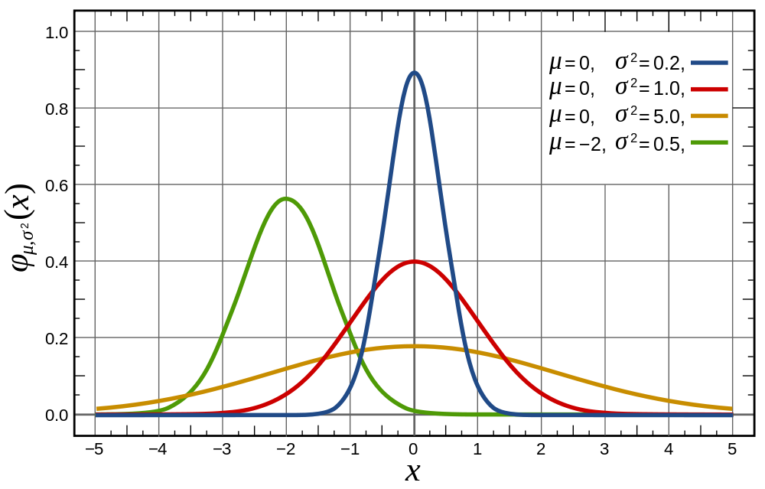
Univariate Gaussian
Source: Wikipedia (Normal Distribution)

Slide 41
Multivariate Gaussians
Source: Lecture notes by Chuong B. Do (IIT Delhi)

Slide 42
Gaussian Mixture Models
Model parameters
Number of components:
“Mixing” weight vector:
For each Gaussian, mean and covariance matrix:
Varying constraints on co-variance matrices
Spherical vs. diagonal vs. full
Tied vs. untied

Slide 43
Learning for Simple Univariate Case
Problem setup:
Given number of components:
Given points:
Learn parameters:
Model selection criterion: maximize likelihood of data
Introduce indicator variables:
Likelihood of the data:

Slide 44
EM to the Rescue!
We’re faced with this:
It’d be a lot easier if we knew the z’s!
Expectation Maximization
Guess the model parameters
E-step: Compute posterior distribution over latent (hidden) variables given the model parameters
M-step: Update model parameters using posterior distribution computed in the E-step
Iterate until convergence

Slide 45
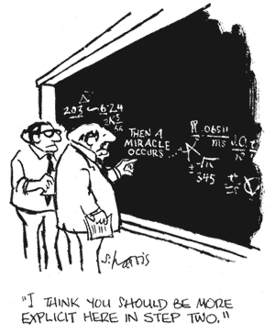

Slide 46
EM for Univariate GMMs
Initialize:
Iterate:
E-step: compute expectation of z variables
M-step: compute new model parameters

Slide 47
MapReduce Implementation
x₁
z_{1,1}
z_{1,2}
…
z_{1,K}
Map
x₂
z_{2,1}
z_{2,2}
z_{2,K}
x₃
z_{2,1}
z_{2,3}
z_{2,K}
…
x_{N}
z_{N,1}
z_{N,2}
z_{N,K}
Reduce

Slide 48
K-Means vs. GMMs
K-Means
GMM
Map
Compute distance of points to centroids
E-step: compute expectation of z indicator variables
Reduce
M-step: update values of model parameters
Recompute new centroids

Slide 49
Summary
Hierarchical clustering
Difficult to implement in MapReduce
K-Means
Straightforward implementation in MapReduce
Gaussian Mixture Models
Implementation conceptually similar to k-means, more “bookkeeping”

Slide 50

Classification
Source: Wikipedia (Sorting)

Slide 51
Supervised Machine Learning
The generic problem of function induction given sample instances of input and output
Classification: output draws from finite discrete labels
Regression: output is a continuous value
Focus here on supervised classification
Suffices to illustrate large-scale machine learning
This is not meant to be an exhaustive treatment of machine learning!

Slide 52
Applications
Spam detection
Content (e.g., movie) classification
POS tagging
Friendship recommendation
Document ranking
Many, many more!

Slide 53
Supervised Binary Classification
Restrict output label to be binary
Yes/No
1/0
Binary classifiers form a primitive building block for multi-class problems
One vs. rest classifier ensembles
Classifier cascades

Slide 54
Limits of Supervised Classification?
Why is this a big data problem?
Isn’t gathering labels a serious bottleneck?
Solution: user behavior logs
Learning to rank
Computational advertising
Link recommendation
The virtuous cycle of data-driven products

Slide 55
The Task
label
Given
(sparse) feature vector
Induce
Such that loss is minimized
loss function
Typically, consider functions of a parametric form:
model parameters

Slide 56
Key insight: machine learning as an optimization problem!
(closed form solutions generally not possible)

Slide 57
Gradient Descent: Preliminaries
Rewrite:
Compute gradient:
“Points” to fastest increasing “direction”
So, at any point:
*
* caveats

Slide 58
Gradient Descent: Iterative Update
Start at an arbitrary point, iteratively update:
We have:
Lots of details:
Figuring out the step size
Getting stuck in local minima
Convergence rate
…

Slide 59
Gradient Descent
Repeat until convergence:

Slide 60
Intuition behind the math…
New weights
Old weights
Update based on gradient

Slide 61
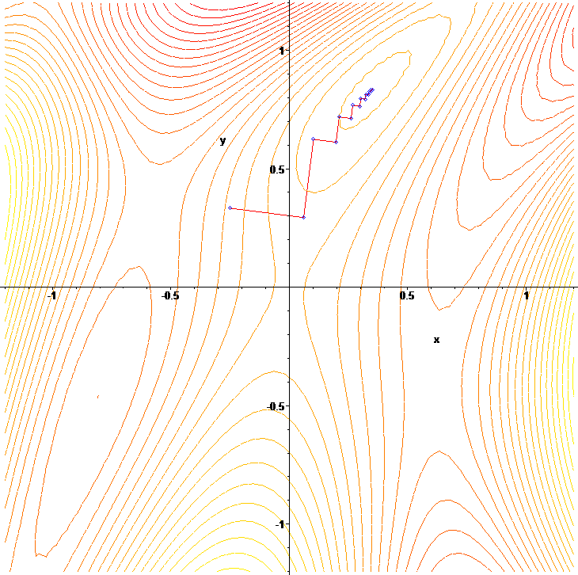
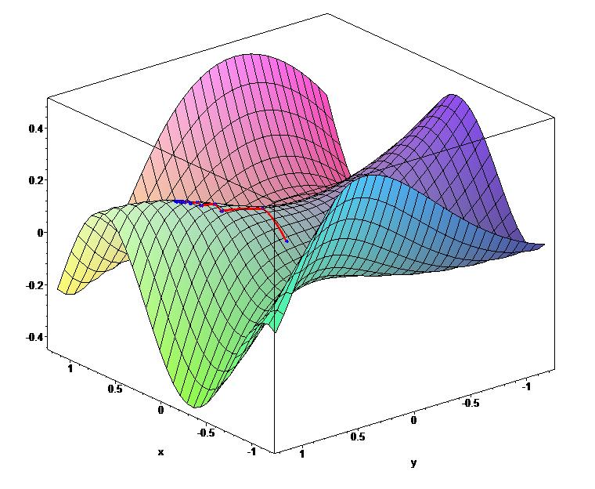

Slide 62
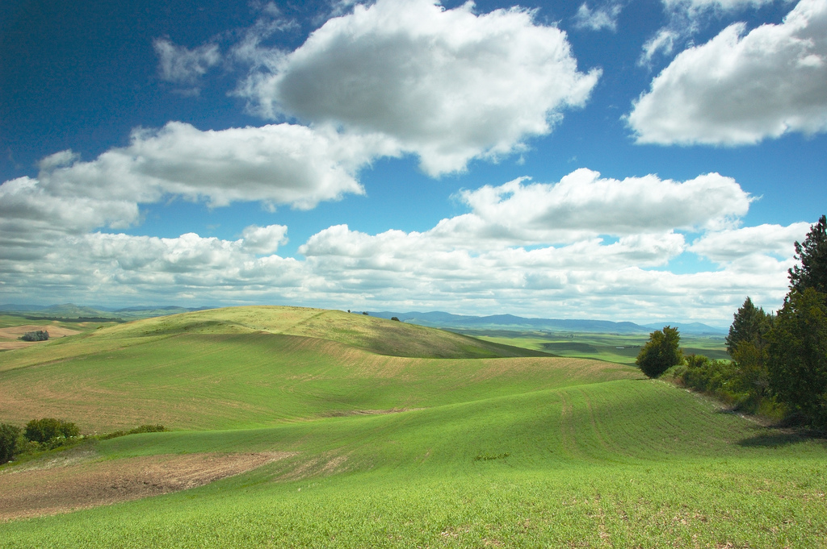
Gradient Descent
Source: Wikipedia (Hills)

Slide 63
Lots More Details…
Gradient descent is a “first order” optimization technique
Often, slow convergence
Conjugate techniques accelerate convergence
Newton and quasi-Newton methods:
Intuition: Taylor expansion
Requires the Hessian (square matrix of second order partial derivatives): impractical to fully compute

Slide 64
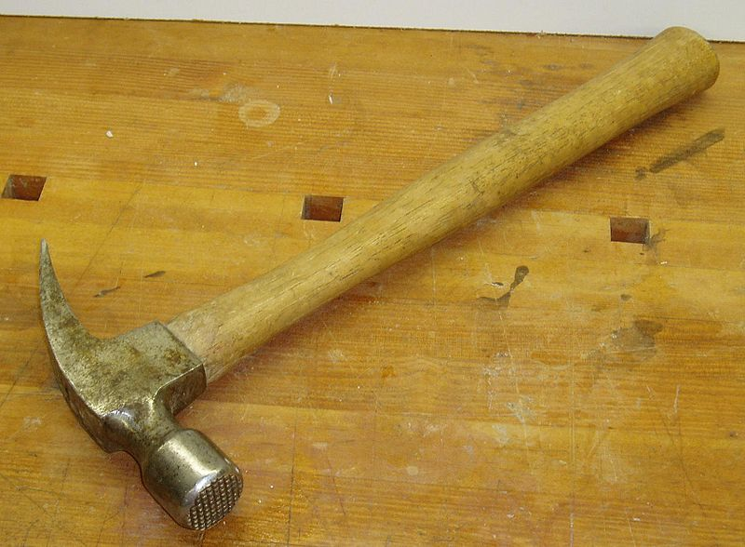
Logistic Regression
Source: Wikipedia (Hammer)

Slide 65
Logistic Regression: Preliminaries
Given
Let’s define:
Interpretation:

Slide 66
Relation to the Logistic Function
After some algebra:
The logistic function:

Slide 67
Training an LR Classifier
Maximize the conditional likelihood:
Define the objective in terms of conditional log likelihood:
We know so:
Substituting:

Slide 68
LR Classifier Update Rule
Take the derivative:
General form for update rule:
Final update rule:

Slide 69
Lots more details…
Regularization
Different loss functions
…
Want more details? Take a real machine-learning course!

Slide 70
MapReduce Implementation
mappers
single reducer
compute partial gradient
mapper
mapper
mapper
mapper
reducer
iterate until convergence
update model

Slide 71
Shortcomings
Hadoop is bad at iterative algorithms
High job startup costs
Awkward to retain state across iterations
High sensitivity to skew
Iteration speed bounded by slowest task
Potentially poor cluster utilization
Must shuffle all data to a single reducer
Some possible tradeoffs
Number of iterations vs. complexity of computation per iteration
E.g., L-BFGS: faster convergence, but more to compute

Slide 72
Gradient Descent
Source: Wikipedia (Hills)

Slide 73
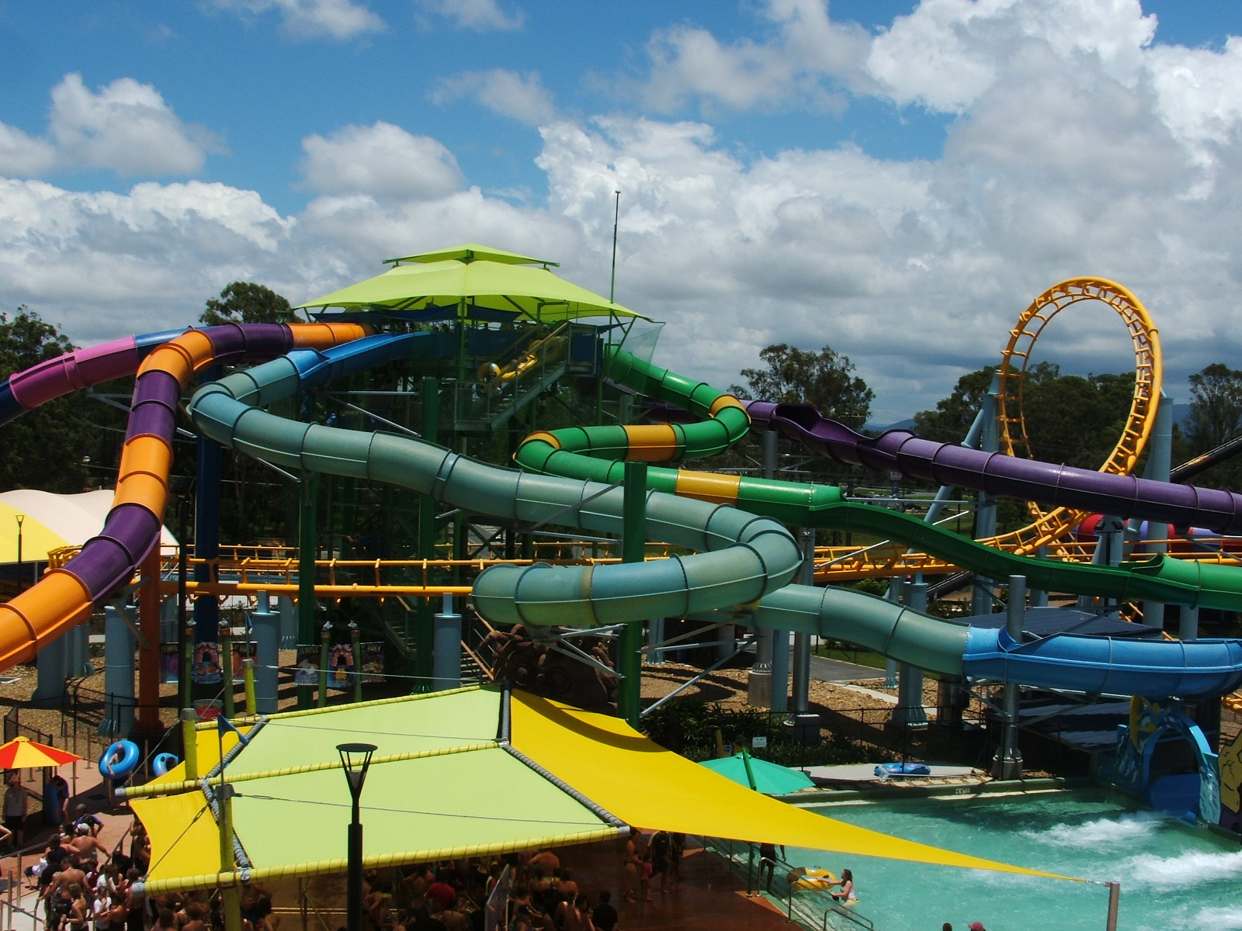
Stochastic Gradient Descent
Source: Wikipedia (Water Slide)

Slide 74
Batch vs. Online
Gradient Descent
“batch” learning: update model after considering all training instances
Stochastic Gradient Descent (SGD)
“online” learning: update model after considering each (randomly-selected) training instance
In practice… just as good!

Slide 75
Practical Notes
Most common implementation:
Randomly shuffle training instances
Stream instances through learner
Single vs. multi-pass approaches
“Mini-batching” as a middle ground between batch and stochastic gradient descent
We’ve solved the iteration problem!
What about the single reducer problem?

Slide 76
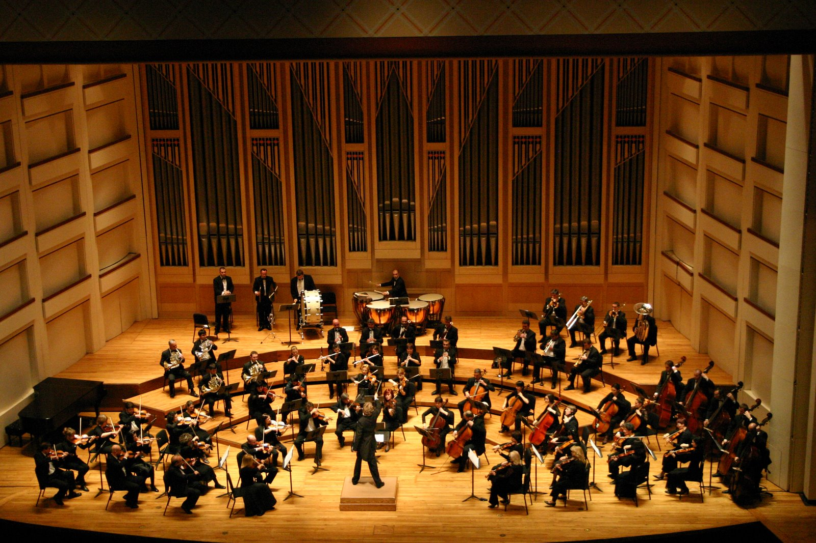
Ensembles
Source: Wikipedia (Orchestra)

Slide 77
Ensemble Learning
Learn multiple models, combine results from different models to make prediction
Why does it work?
If errors uncorrelated, multiple classifiers being wrong is less likely
Reduces the variance component of error
A variety of different techniques:
Majority voting
Simple weighted voting:
Model averaging
…

Slide 78
Practical Notes
Common implementation:
Train classifiers on different input partitions of the data
Embarassingly parallel!
Contrast with bagging
Contrast with boosting

Slide 79
MapReduce Implementation
training data
training data
training data
training data
mapper
mapper
mapper
mapper
model
model
model
model

Slide 80
MapReduce Implementation: Details
Shuffling/resort training instances before learning
Two possible implementations:
Mappers write model out as “side data”
Mappers emit model as intermediate output

Slide 81
Sentiment Analysis Case Study
Lin and Kolcz, SIGMOD 2012
Binary polarity classification: {positive, negative} sentiment
Independently interesting task
Illustrates end-to-end flow
Use the “emoticon trick” to gather data
Data
Test: 500k positive/500k negative tweets from 9/1/2011
Training: {1m, 10m, 100m} instances from before (50/50 split)
Features: Sliding window byte-4grams
Models:
Logistic regression with SGD (L2 regularization)
Ensembles of various sizes (simple weighted voting)

Slide 82
Diminishing returns…
Ensembles with 10m examples better than 100m single classifier!
“for free”
single classifier
10m ensembles
100m ensembles

Slide 83
Takeaway Lesson
Big data “recipe” for problem solving
Simple technique
Simple features
Lots of data
Usually works very well!

Slide 84
Today’s Agenda
Clustering
Classification

Slide 85

Questions?
Source: Wikipedia (Japanese rock garden)

